Slide 1

POWER MANAGEMENT DEPARTMENT DURGAPUR STEEL PLANT STEEL AUTHORITY OF INDIA

Slide 2
FUNCTION OF THE DEPARTMENT
Ensuring Uninterrupted Power supply.
Ensuring Safety of Working Personnel and Equipment.
Operation and maintenance of the Power distribution network of DSP.
Optimization of Power cost by control and monitoring Power supply from different sources.
Calibration and testing of protective relays and measuring instruments.
Maintenance of underground and overhead Cable network 33KV /11KV/415V
Maintaining Area Lighting inside plant (Streets & High Mast ).

Slide 3
SOURCES OF POWER
220KV Purchased Power from DVC- Parulia at 100MVA CD.
2X60 MW CPP (NSPCL )
4X 5 MW OPP ( Avg. Generation 6-7 MW ).
A new 2X20 MW NPP is under construction ( expected commissioning of one unit in December 2021 and another in March 2022 )

Slide 4
GENERATION OF POWER FROM CPP & OPP
GENERATION
CAPTIVE POWER PLANT
THERMAL POWER PLANT(COAL FIRED) HAVING 2 UNIT OF 60 MW EACH & GENERATING 120 MW
OLD POWER PLANT:
THERMAL POWER PLANT (COAL FIRED) HAVING 4 UNIT OF 5MW EACH
GENERATING ONLY 6-7 MW
UPCOMING NEW POWER PLANT 2X20 MW
THERMAL POWER PLANT (COAL FIRED)

Slide 5
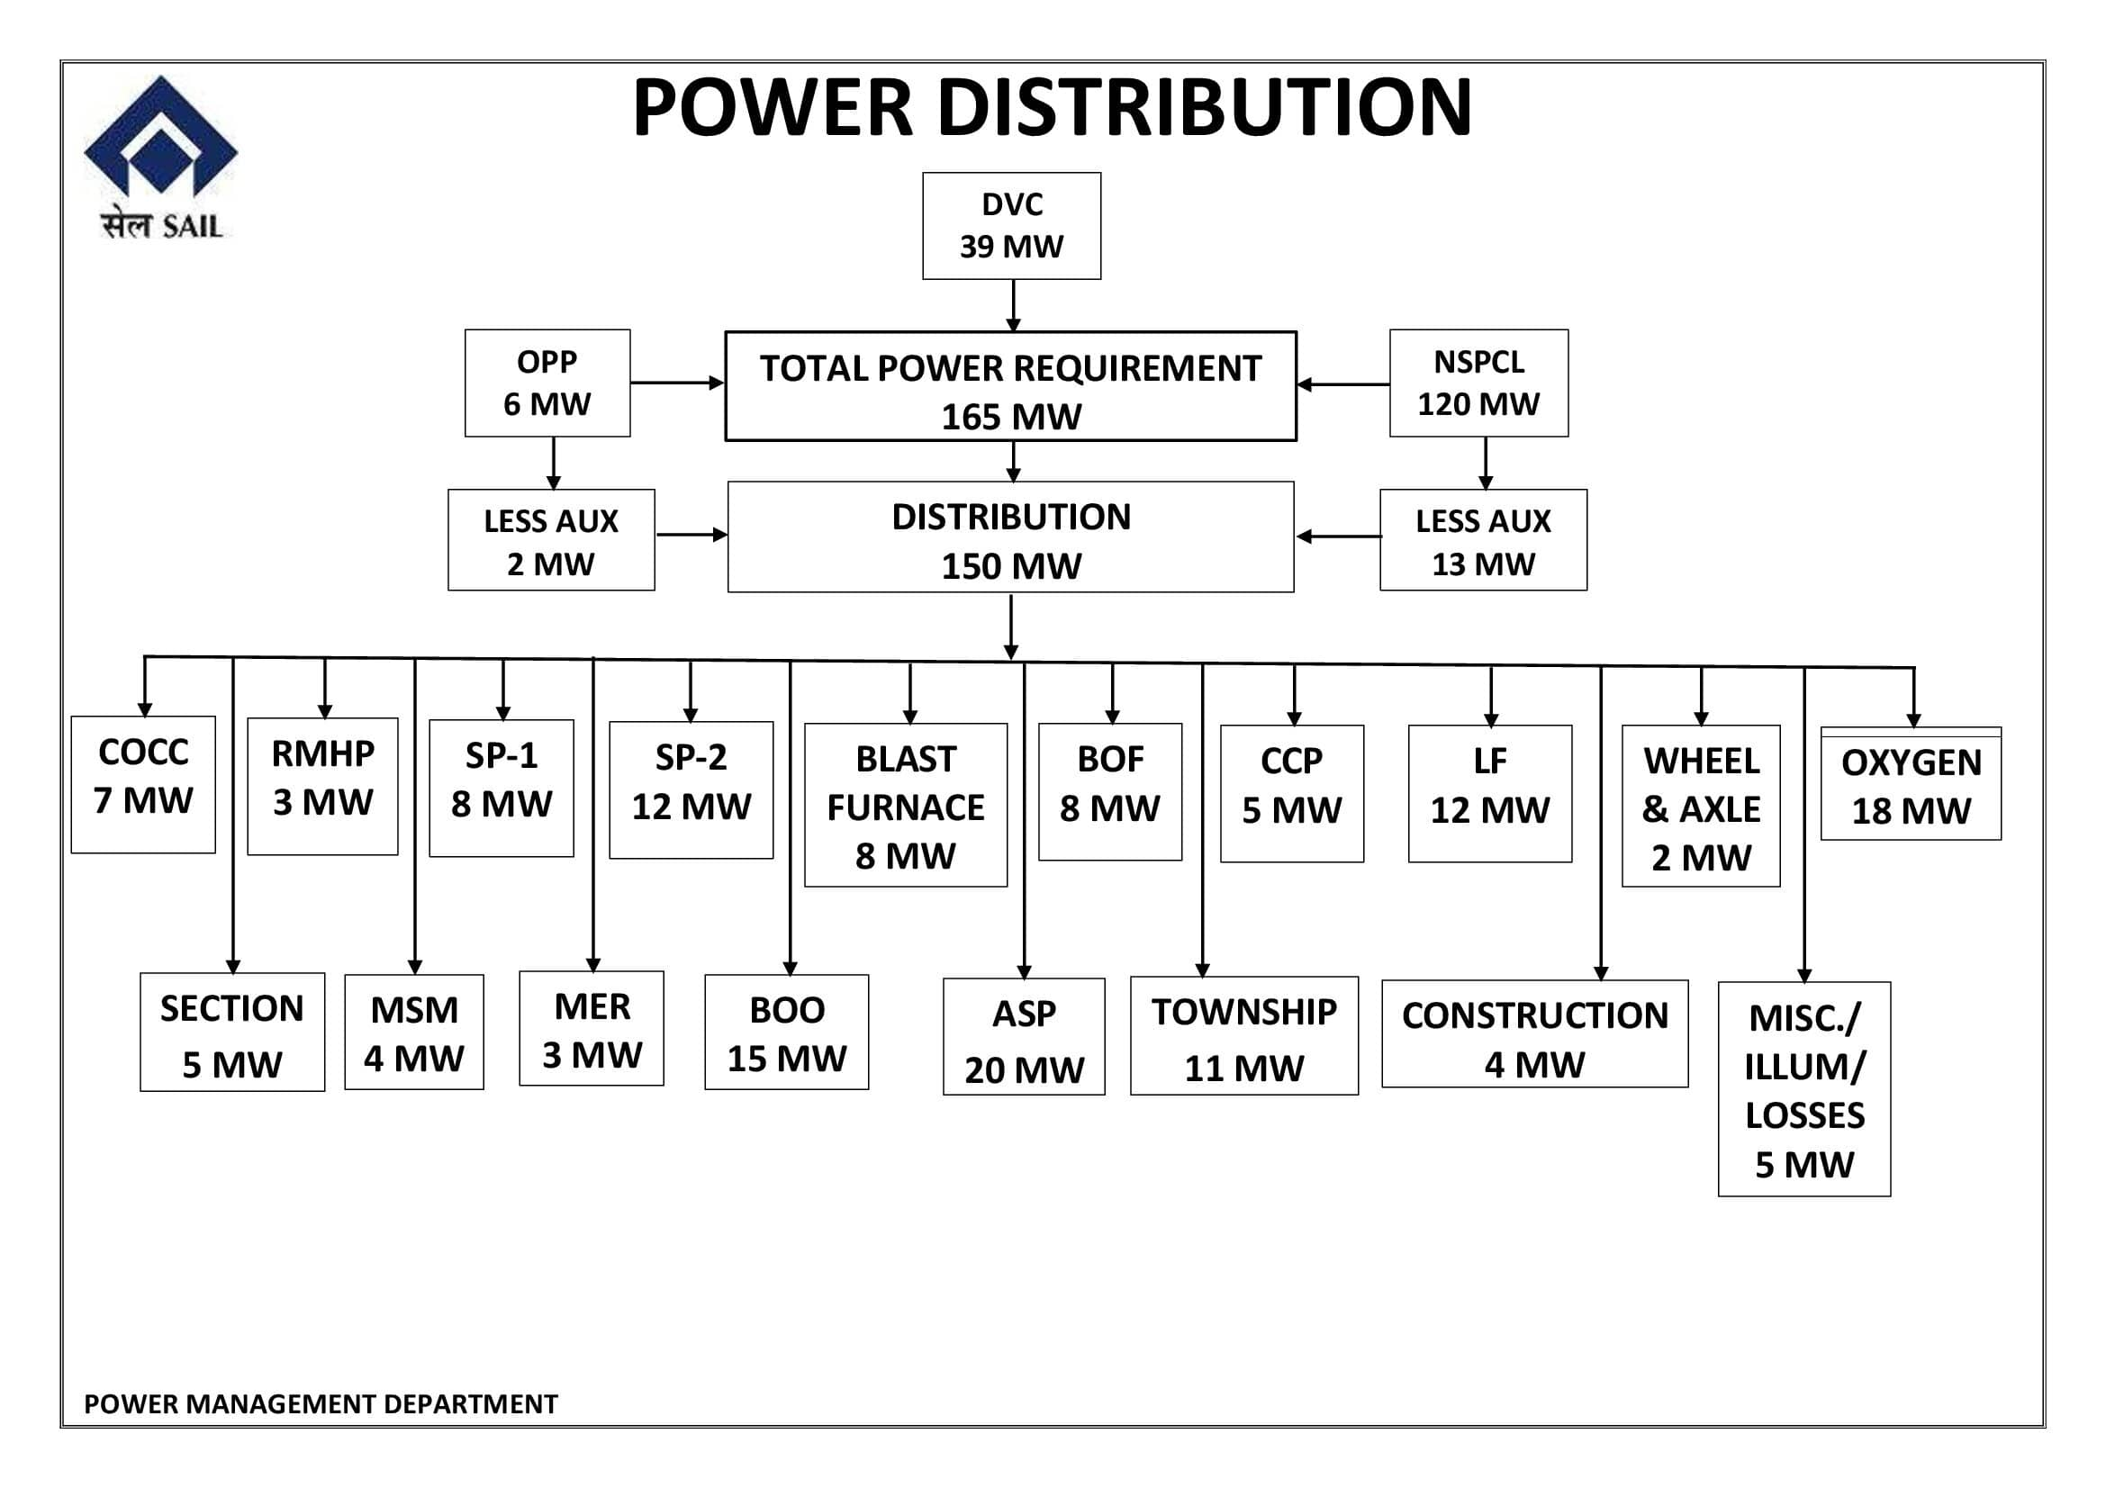
POWER SOURCES & DISTRIBUTION

Slide 6
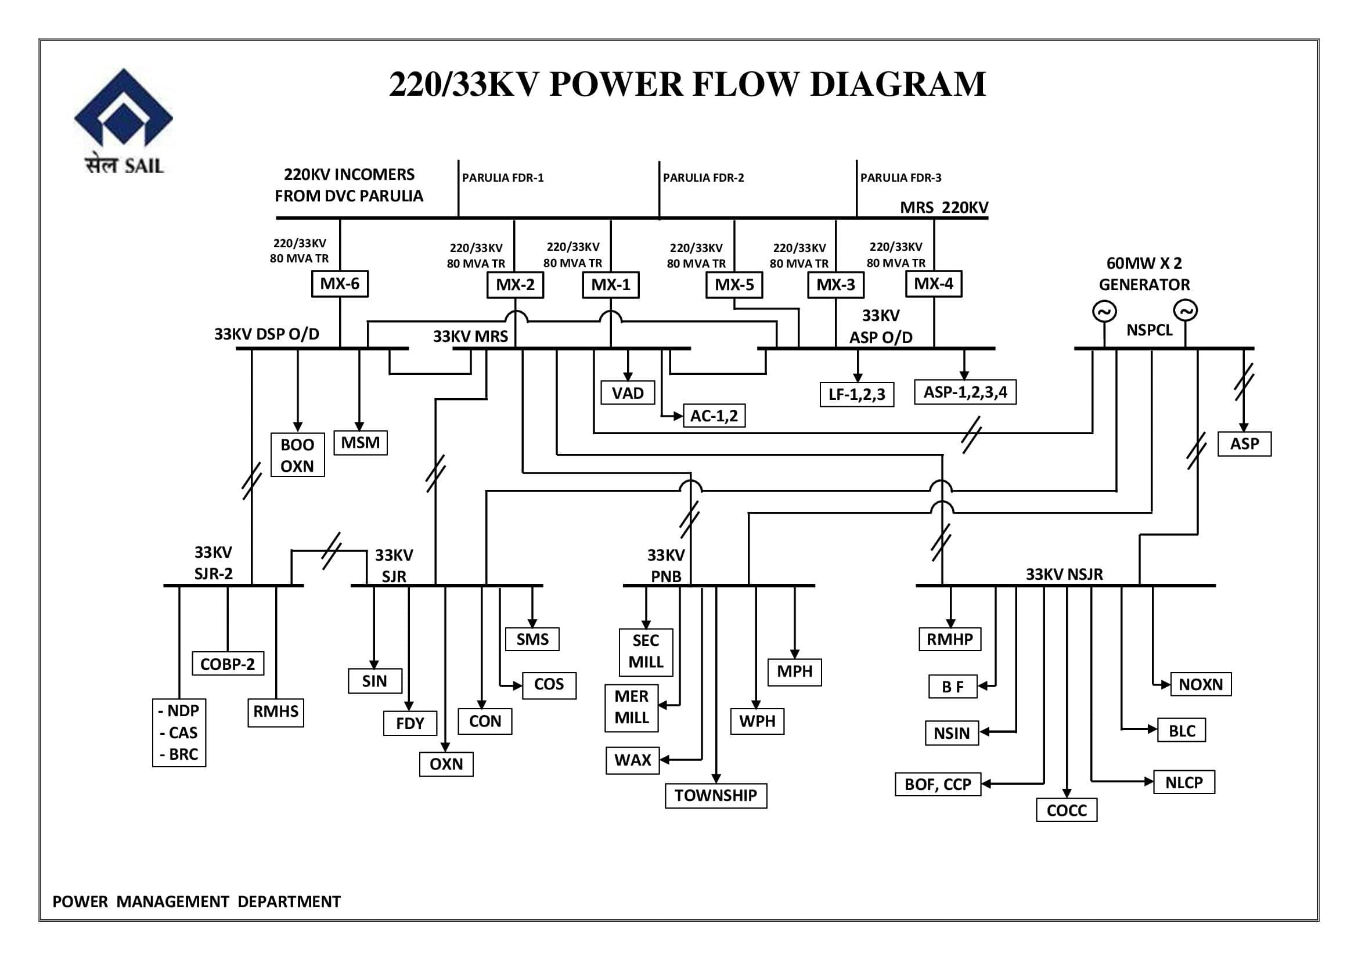
POWER FLOW DIAGRAM OF DSP

Slide 7
PMD MAJOR WORK AREAS
PMD
OPERATION
CABLES
MAINT.
TECH. CELL
STORES
TESTING
CZM-OXY,SLB & SERVICES
D1ZM-SINTER AND BF AREA
D2ZM-CO & CC AREA
EZM-MRS, SMS,MSM & BRC
BZM-IRON & STEEL , RMHP AREA
AZM-MILLS ,WPH & TOWNSHIP

Slide 8
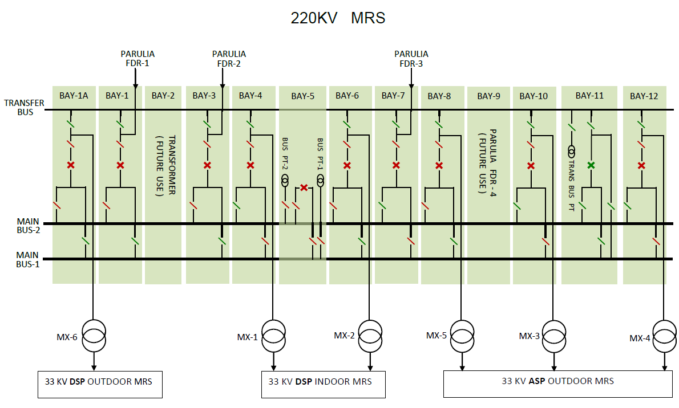
220 KV MAIN RECEIVING SUBSTAION

Slide 9
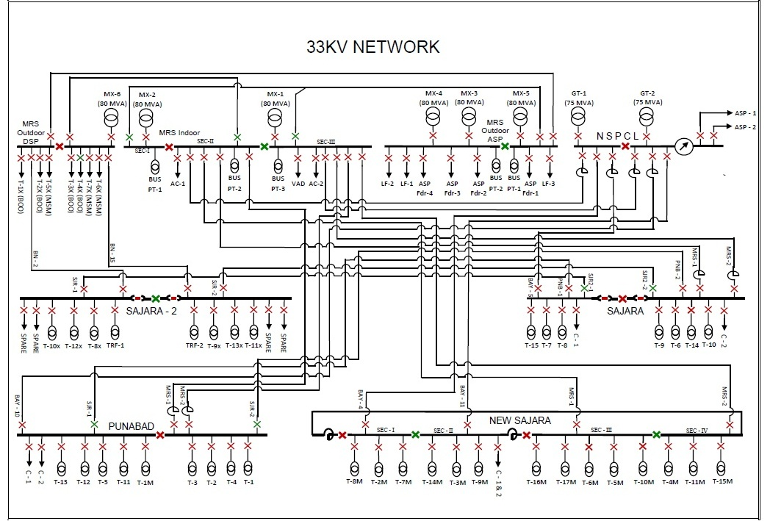
33KV DISTRIBUTION NETWORK

Slide 10
MAJOR DISTRIBUTION CENTERS
220KV Outdoor Main Receiving Station
33KV Indoor Substation – DSP at MRS
33KV Outdoor Substation – DSP at MRS
33KV Outdoor Substation - ASP at MRS
33KV Indoor Substation – Punabad
33KV Indoor Substation - New Sajara
33KV Indoor Substation – Sajara
33KV Indoor Substation – Sajara-2
33KV NPH indoor substation near Blast Furnace (under commissioning)

Slide 11
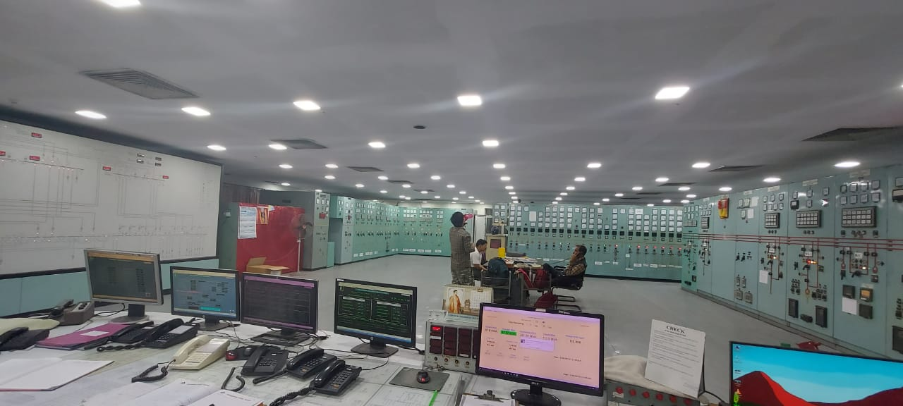
GLIMPSES OF MRS CONTROL ROOM

Slide 12
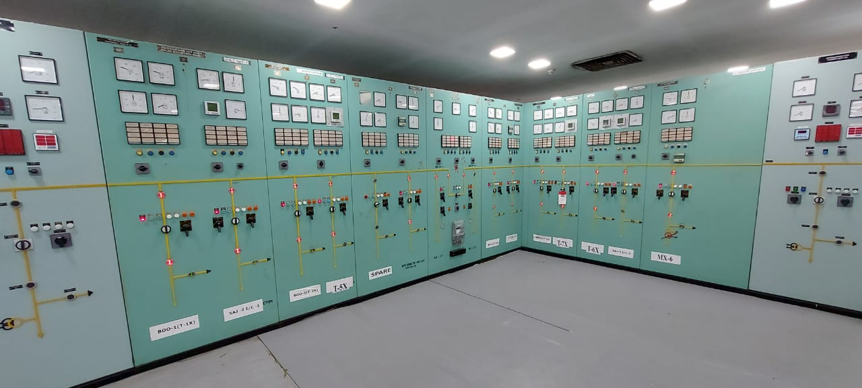
GLIMPSES OF MRS CONTROL ROOM

Slide 13
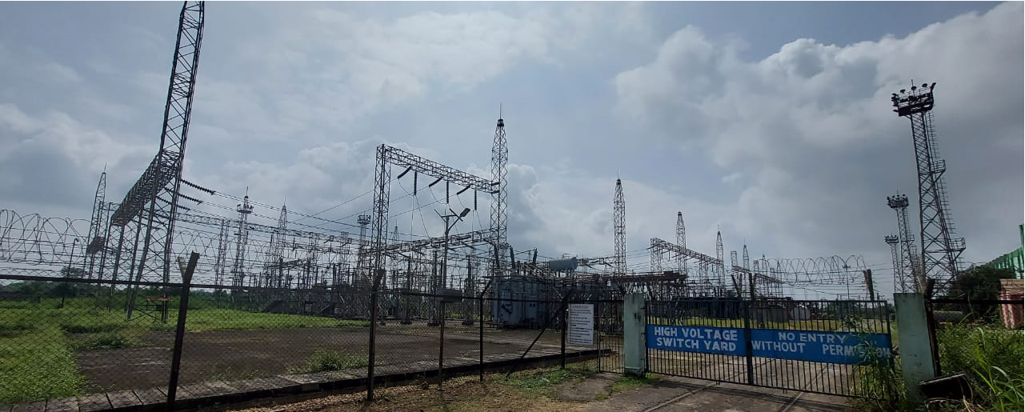
MRS 220 KV SWITCHYARD

Slide 14
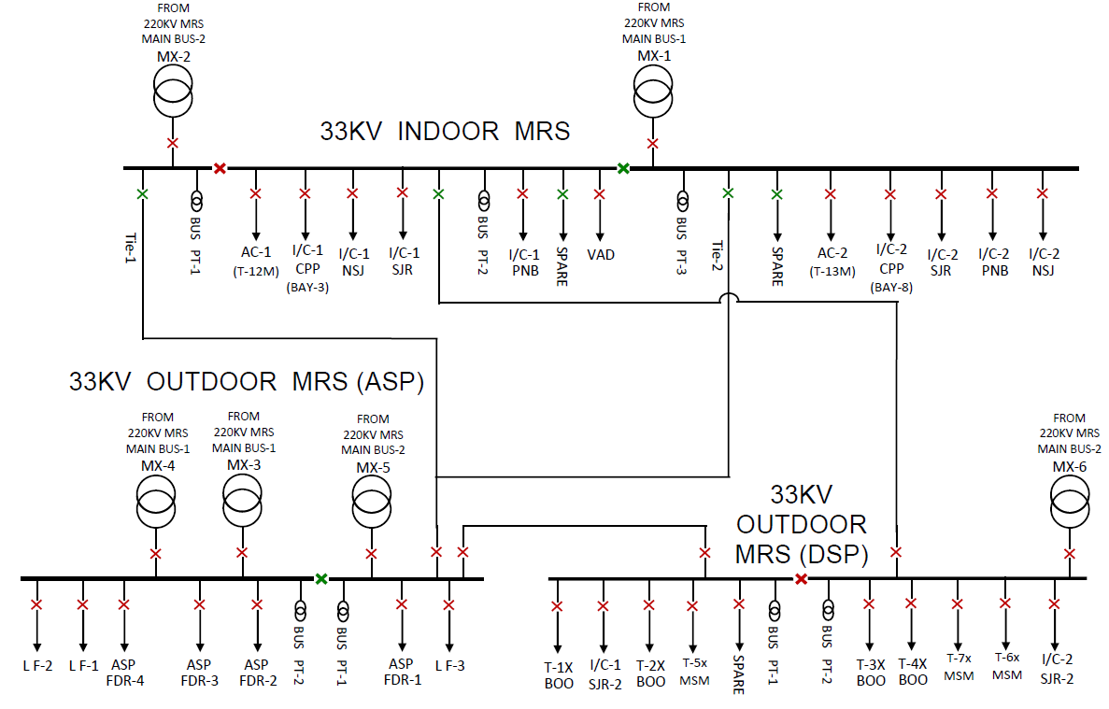
33KV MRS

Slide 15
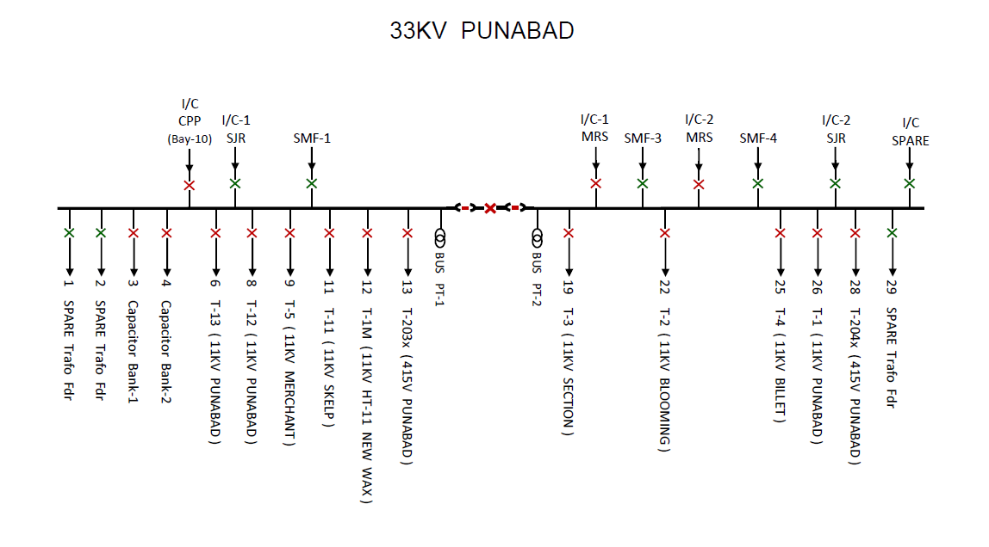
33 KV PUNABAD

Slide 16
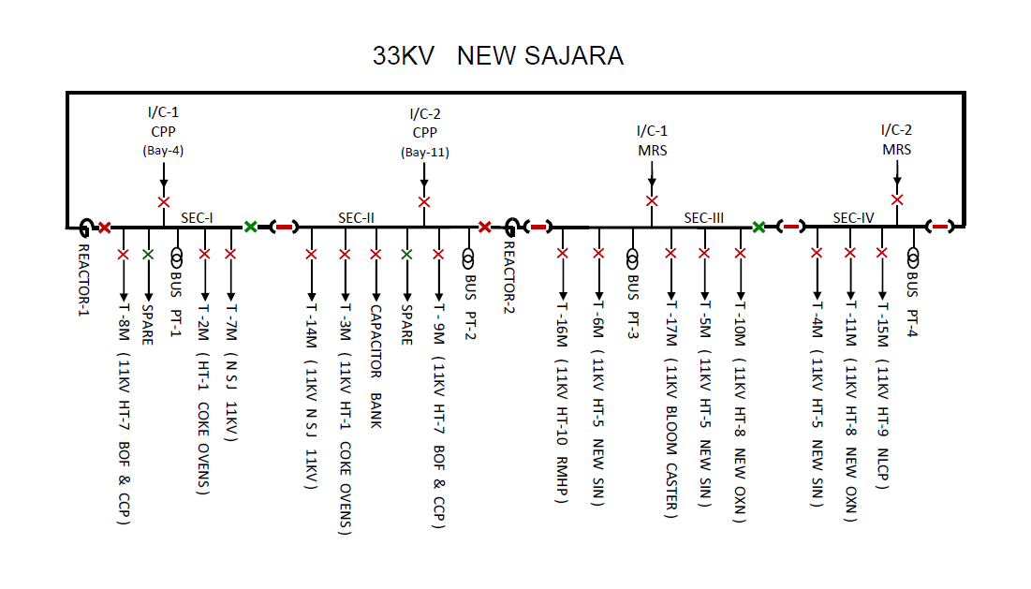
EXISTING 33KV NEW SAJARA

Slide 17
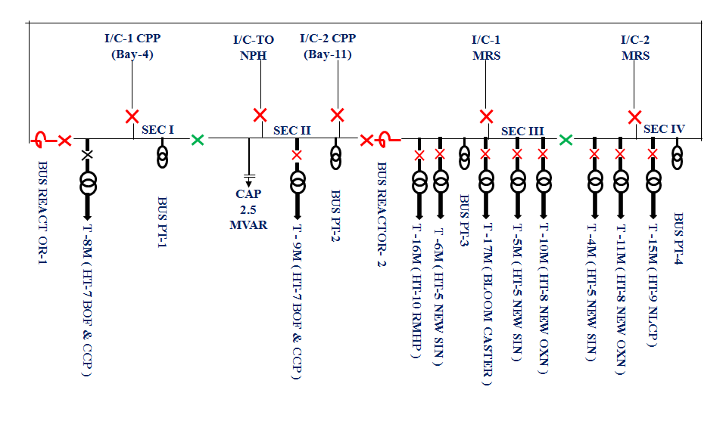
PROPOSED 33KV NEW SAJARA

Slide 18
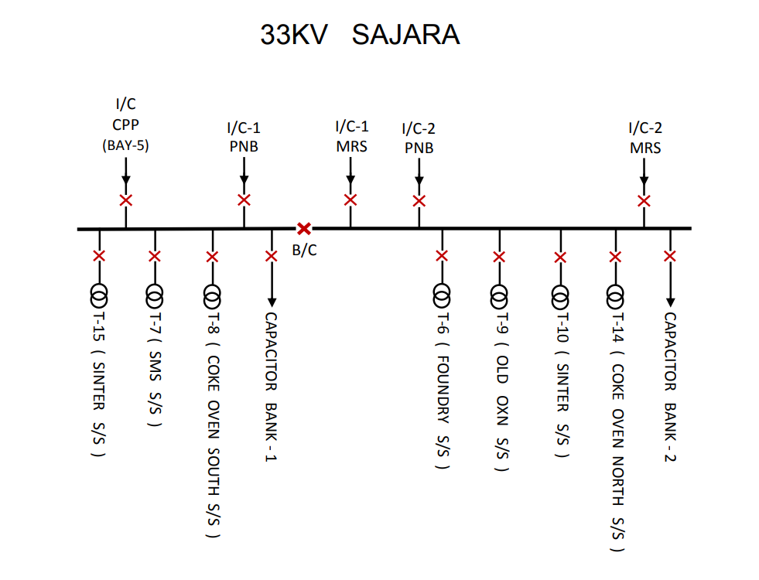
EXISTING 33 KV SAJARA

Slide 19
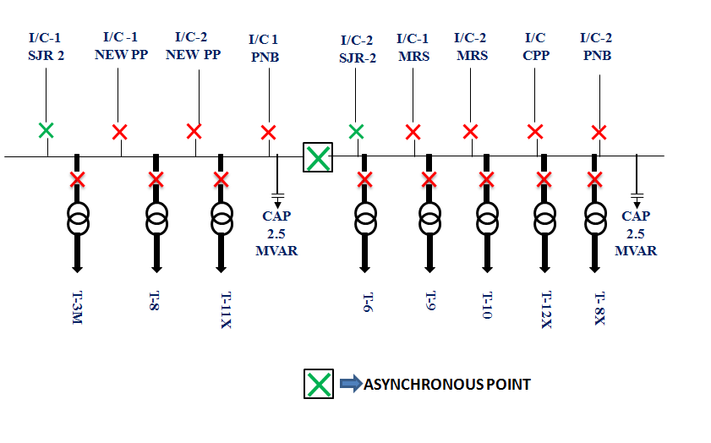
PROPOSED 33KV SAJARA

Slide 20
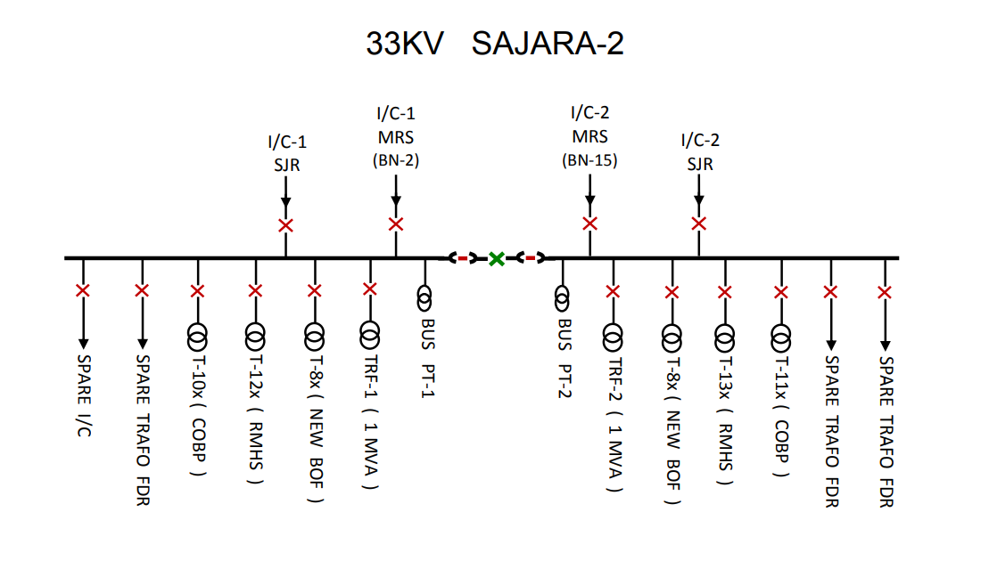
EXISTING 33KV SAJARA-2

Slide 21
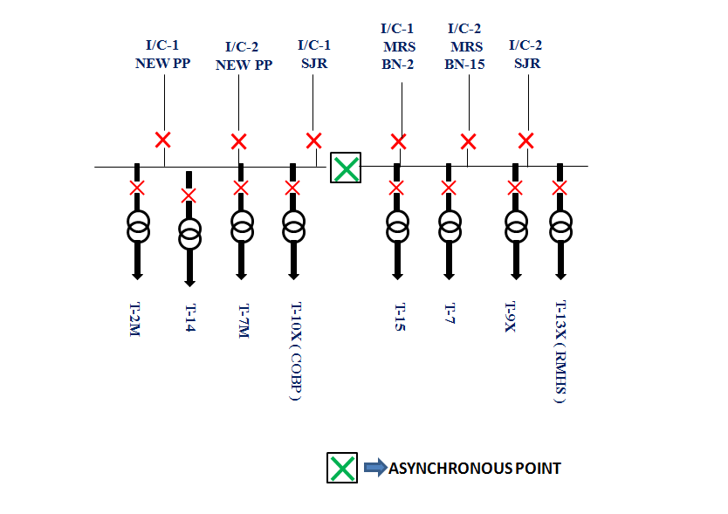
PROPOSED 33KV SAJARA-2

Slide 22
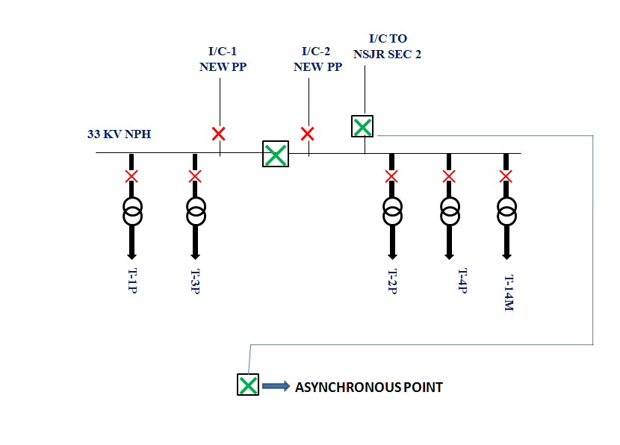
33 KV NEW SUBSTATION(NPH) (NPH)

Slide 23
SAFETY
CONDITION MONITORING
PREVENTIVE MAINTENANCE
MAINTENANCE PRACTICES

Slide 24
CERTIFICATION STANDARDS IN PMD
Maintaining ISO 9001:2015 (QMS) Standard.
Maintaining ISO 50001 :2018(EnMS) Standard.
Maintaining ISO 14001:2015 (EMS) Standard.
Maintaining SA 8000 Standard.

Slide 25
QUALITY OBJECTIVES 2021-22
Ensuring power availability to all shops of DSP by Keeping power interruptions within 8 nos. in 2021-22
Maintain MD Demand for DVC Power Within 100MVA for two NSPCL units operation, 120 MVA for one unit & 140 MVA for no unit.

Slide 26
EMS OBJECTIVES 2021-22
Disposal of used 25KL transformer oil .
Disposal of 10 Nos. E Waste through ETL.
EnMS OBJECTIVES 2021-22
To reduce PMD power consumption by 5% w.r.t. 2020-21 & to maintain monthly Power consumption within 249.286 MWH
To maintain Power factor of DVC power between 0.991-1.000 for peak, off peak & normal hours each

Slide 27
TRASFORMERS
To meet the requirement of power through out the plant
PMD has different Transformer based on MVA rating.
Rating which are as under:
MVA RATING | 80 | 16 | 10 | 4 | 3.5 | 2 | 1.6 | 1.5 | 1 | TOTAL
NO. OF TRAFO. | 6 | 5 | 45 | 27 | 19 | 12 | 76 | 42 | 14 | 246

Slide 28
TYPE OF TRANSFORMERS
Type | MVA rating | Voltage ratio | Cooling system | Phasor group
Oil filled | 80 | 220/33kV | ONAF | Y-Yn0
 | 16 | 33/11kV | ONAN | Dyn11
 | 10 | 33/11kV | ONAN | Dyn11
 | 4 | 11/3.3kV | ONAN | Dyn11
 | 3.5 | 11/3.3kV | ONAN | Dyn11
 | 1.6 | 11/.415kV | ONAN | Dyn11
 | 1.5 | 11/.415kV | ONAN | Dyn11
 | 1 | 33/.415kV | ONAN | Dyn11
 | 1 | 11/.415kV | ONAN | Dyn11
Dry type | 2 | 11/.415kV | ONAN | Dyn11

Slide 29
TYPES OF CIRCUIT BREAKERS
Type | Make | Voltage grade | Rating
GCB | CGL | 220KV
GCB | ABB | 33KV
VCB | SCHNEIDER | 33KV
 | SIEMENS | 33KV
 | L&T | 33KV
GCB | ABB | 11KV | 1250A
VCB | CGL | 11KV | 2000A
 | L&T | 11KV | 1250A
 | BICCOLAWRIE | 11KV | 2000A
OCB | EE | 11KV | 800/400A
 | C&P | 11KV | 800/400A
 | BICCOLAWRIE | 11KV | 800/400A
GCB | ABB | 3.3KV | 1250A

Slide 30
CONTINUED…….
Type | Make | Voltage grade | Rating
VCB | AY | 3.3KV | 600A,400A
ACB | MV | 3.3KV | 600A,400A
 | W&B | 3.3KV | 600A,400A
ACB | SCHNEIDER | 415V | 3200A,1600A
 | SIEMENS | 415V | 1000A
 | ABB | 415V | 4000A, 3200A,1000A
 | L&T | 415V | 3200A, 1000A, 800A,600A
 | EE(OB3) | 415V | 2000A, 1000A
 | EE(EMPACT) | 415V | 2000A, 1000A
 | C&P | 415V | 2000A, 1200A
 | GE | 415V | 3200A

Slide 31
RELAY AND TYPE OF PROTECTION
In PMD we are using both electromechanical as well as
Numerical relay.
Numerical relay | Electromechanical relay
Featured with low power consumption. Highly resistant to shock and vibration. Respond to control signal less than 100 micro-second. Do not generate sparks or electric arcs. | Require high power to operate. Mechanical system is subjected to external disturbances that can lead to unreliable operation. Can respond to control signal 5-10 mili-seconds slower as comparison to digital. Can generate arc when they interrupt current.

Slide 32
RELAY TYPE,MAKE AND DESCRIPTION
ELECTROMECHANICAL RELAY
Type | Make | Description
CDG | EE | Over-current and earth fault.
ICM | ABB | Over-current and earth fault
CAG | EE | Inst. Earth Fault and REF
VDG | EE | Under voltage
SKD/SKE | EE & ALSTOM | Check synchronizing relay
CTMM | EE | Motor protection relay
CTM
CTMFM
DTH | EE | Trafo. diff. relay

Slide 33
CONTINUED…..
Type | Make | Description
HORM4 | EE | Line diff. relay
H02
VAA | EE | Auxiliary relay
TFE | Metrovicks & AEI | Motor protection relay
P & BGOLD | P & BGOLD | Motor protection relay

Slide 34
CONTINUED…..
NUMERICAL RELAY:
Type | Make | Description
P122 | Schneider | Over-current and earth fault.
P127 | Schneider | Over-current and earth fault.(Directional)
MJT | Easun Reyrole | Over-current and earth fault.
P521 | Schneider | Line diff. relay
P442 | Schneider | Distance protection relay
MFVUM | EE | Under / over frequency
FCX | EE | df/dt relay
P220 | Schneider | Motor protection relay
p242 | Schneider | Motor protection relay with diff. feature

Slide 35
CONTINUED……
Type | Make | Description
RED615 | ABB | Over-current and earth fault.
RED615 | ABB | Line diff. relay
RET615 | ABB | Trafo. Diff. protection
REU615 | ABB | Under voltage relay
REB611 | ABB | Bus-bar diff. protection relay
SIPROTECH 7SJ | SIEMENS | Over-current and earth fault.
RAZOA | ABB | Distance protection
P11 | Schneider | Over-current and earth fault.

Slide 36
TYPE OF CABLE(OVERHEAD AND UNDERGROUND)
TYPE | VOLTAGE LEVEL | CROSS SECTION(mm^2)
PILC | 33KV | 400, 300
 | 11KV | 240, 185, 150
 | 3.3KV | 240, 185, 150, 120, 95
 | 415V | 300, 240, 185, 150, 95, 70, 50
PVC | 3.3KV | 240, 185, 150, 120, 95
 | 415V | 300, 240, 185, 150, 95, 70, 50, 35, 25, 16
XLPE | 33KV | 400, 300, 240
 | 11KV | 240, 185, 150
 | 3.3KV | 240, 185, 150, 120, 95
 | 415V | 25, 16

Slide 37
LENGTH OF CABLE NETWORK
Voltage level | Underground length(km) | Overhead length(km)
33KV | 50 | 28
11KV | 55 | 4
3.3KV | 25 | 2
415V | 50 | 6

Slide 38
SHOPWISE POWER CONSUMPTION
SHOP NAME | ENERGY CONSUMPTION(18-19) (in MU) | ENERGY CONSUMPTION(19-20) (in MU) | ENERGY CONSUMPTION(20-21) (in MU)
COKE OVENS | 69.92 | 71.15 | 35.80
RMHP | 24.58 | 23.24 | 5.72
SP | 163 | 167.69 | 48.32
NLCP | 25.13 | 24.48 | 25.24
BOF | 70.03 | 70.44 | 68.49
LF-1 | 32.02 | 31.47 | 30.95
LF-2 | 33.41 | 33.51 | 31.27
LF-3 | 32.20 | 31.77 | 29.64
OXYGEN PLANT | 158.16 | 152.75 | 161.51
SEC. MILL | 15.39 | 14.92 | 12.00
MER. MILL | 17.05 | 16.93 | 15.21
W&A | 7.84 | 9.45 | 9.13

Slide 39
CONTINUED……
VAD | 7.6 | 5.11 | 1.26
MSM | 28.66 | 35.43 | 27.51
POWER CONSUMPTION DSP, ASP AND BOO PLANT
Name | Energy consumption(in MU ) in 18-19 | Energy consumption(in MU ) in 19-20 | Energy consumption(in MU ) in 20-21
DSP | 1146 | 1008 | 975
ASP | 139 | 166 | 117
BOO | 130 | 120 | 84

Slide 40
SPECIFIC POWER CONSUMTION(KWH/TSS)
2018-2019 |  | 2019-2020 |  | 2020-2021
Target (KWH/TSS) | Actual (KWH/TSS) | Target (KWH/TSS) | Actual (KWH/TSS) | Target (KWH/TSS) | Actual (KWH/TSS)
407.30 | 410.49 | 409.69 | 424.69 | 410.03 | 419.87

Slide 41
POWER BILL OF DSP, ASP & CPP
CPP POWER BILL:
DVC POWER BILL:
2018-2019 |  | 2019-2020 |  | 2020-2021
CONSUMPTI-ON (IN MU) | RUPEES (IN Cr.) | CONSUMPTI-ON (IN MU) | RUPEES (IN Cr.) | CONSUMPTI- ON (IN MU) | RUPEES (IN Cr.)
856.58 | 535.36 | 807.12 | 504.45 | 746.63 | 462.16
2018-2019 |  | 2019-2020 |  | 2020-2021
CONSUMPTI-ON (IN MU) | RUPEES (IN Cr.) | CONSUMPTI-ON (IN MU) | RUPEES (IN Cr.) | CONSUMPTI- ON (IN MU) | RUPEES (IN Cr.)
380.57 | 203.45 | 428.19 | 225.03 | 377.782 | 202.09

Slide 42
ASP POWER BILL:
2018-2019 |  | 2019-2020 |  | 2020-2021
CONSUMPTI-ON (IN MU) | RUPEES (IN Cr.) | CONSUMPTI-ON (IN MU) | RUPEES (IN Cr.) | CONSUMPTI- ON (IN MU) | RUPEES (IN Cr.)
164.46 | 98.28 | 166.46 | 98.27 | 117.66 | 69.23
DSP POWER BILL:
2018-2019 |  | 2019-2020 |  | 2020-2021
CONSUMPTI-ON (IN MU) | RUPEES (IN Cr.) | CONSUMPTI-ON (IN MU) | RUPEES (IN Cr.) | CONSUMPTI- ON (IN MU) | RUPEES (IN Cr.)
1072.69 | 641.66 | 1068.84 | 631.21 | 1006.74 | 595.02

Slide 43
COST REDUCTION FROM PF REBATE
2018-2019 (In Lakhs) | 2019-2020 (In Lakhs) | 2020-2021(In Lakhs)
117.93 | 131.18 | 99.17

Slide 44
Major PROJECT , IPU R&M and Purchase cases of PMD
PROJECTS JOBS | IPU JOBS | CONTRACTS JOBS
2X20MW NPP Power evacuation Project. Power supply to SMS Secondary emission. SMS Converter shell changing Project. CHP 3.3KV Crusher motor changing Project . Roof top Solar Power Project. New Wagon Tippler New BOO Oxygen Plant & enabling package for cable diversion Stamp Charging 8th Boiler & enabling package for cable diversion Emergency Power to Coke Oven. | 4 Nos. 33KV Reactor installation at MRS. 11KV PUNABAD Power Augmentation job. 33.KV cable Replacement job Phase-II. 11KV cable Replacement job Phase-II. 11KV OCB replacement job at OXN-SKD-SLB. FDA at MRS-NSJR-Cable Tunnel MRS to PNB. Installation of 1 no. 33KV Reactor at NSJR. Installation of 1 no. 80MVA Transformer MX#7 with 220KV & 33KV Bay. Replacement of 33KV Indoor switchboard at MRS by GIS. SCADA Up-gradation. | 33KV VCB retrofitting at NSJR. 11KV VCB installation at WAX. 3.3KV VCU installation for BF-4 SGP drives.

Slide 45
MANPOWER STATUS
Maintenance |  | Operation |  | Testing | Cable | Office
Zone | Manpower | S/S | Manpower | Manpower | Manpower | Manpower
A | 8 | MRS | 11 | 12 | 9 | 5
 |  | PNB | 10
B | 7
 |  | NSJR | 9
C | 7
 |  | CON | 10
 |  | HT-14 | 10
D1 | 8
 |  | HT-7A | 7
D2 | 6 | HT-7 | 7
E | 10 | HT-8 | 7
TOTAL | 46 | TOTAL | 71 | 12 | 9 | 5
TOTAL NUMBERS OF EXECUTIVE=21 TOTAL MANPOWER=143

Slide 46
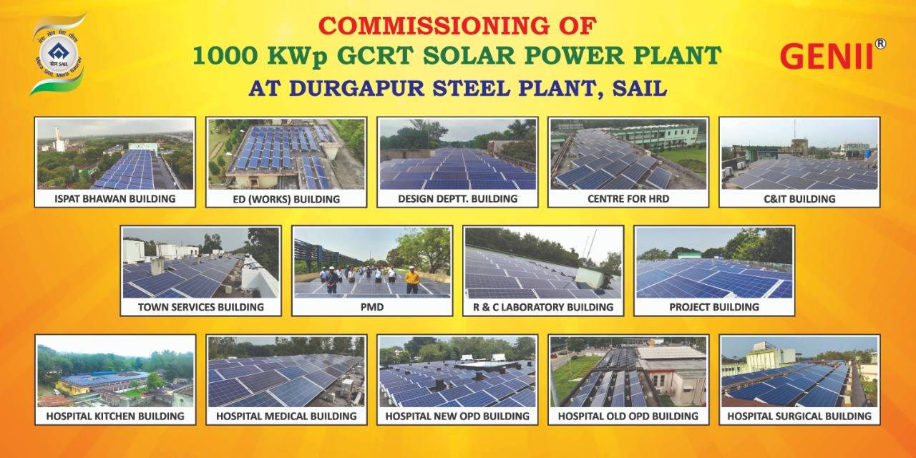
RENEWABLE POWER
Commissioning of 1MWp Grid Connected Roof Top Solar Plant On 10 Nos. building in DSP & Main hospital.

Slide 47
PROPOSED 33 KV POWER DISTRIBUTION NET WORK OF NEW-PP AND MRS O/D
˷
˷
20 MW
20 MW
40 MVA Line Reactor
30 MVA
11.5/34.5 KV
30 MVA
11.5/34.5 KV
40 MVA Line Reactor
MX-6
N PP 33 KV
DSP MRS 33 KV
DSP-O/D
I/C SJR-2
I/C SJR-2
I/C SJR-2
ASP O/D
DSP I/D-2
I/C SJR-2
I/C NPH
I/C SJR
I/C NPH
I/C SJR
→ SYNCHRONISATION POINTS

Slide 48
PROPOSED 33 KV POWER DISTRIBUTION NETWORK OF NPH
I/C-1
NEW PP
I/C-2
NEW PP
I/C TO
NSJR SEC 2
33 KV NPH
T-1P
T-3P
T-14M
T-2P
T-4P
ASYNCHRONOUS POINT

Slide 49
PROPOSED 33 KV POWER DISTRIBUTION NETWORK OF MRS,SJR-2,SJR &PNB
FROM 220 KV PARULIA
FROM 220 KV PARULIA
FROM 220 KV PARULIA
MX-6
MX-1
MX-2
DSP MRS DSP-O/D-I
DSP MRS DSP-O/D-II
DSP MRS
DSP I/D -3
33 KV
DSP MRS
DSP I/D -2
33 KV
DSP MRS
DSP I/D -1
33 KV
40
MVA
25
MVA
40
MVA
25
MVA
25
MVA
25
MVA
SJR-2 LHS
33KV
25
MVA
25
MVA
33 KV SJR LHS
SJR-2 RHS
33KV
33 KV SJR – RHS
CAP
2.5
MVAR
PNB - LHS
33 KV
PNB - RHS
33 KV
CAP
2.5 MVAR
CAP
2.5 MVAR
CAP
2.5 MVAR
NEW PP
33 KV
GRID SYNCHRONISATION POINTS
CPP INTERCONNECTORS ARE NOT SHOWN HERE. ALL I/C’S FROM CPP WILL REMAIN IN PRESENT LOCATION EXCEPT BAY 5. IT IS TO BE SHIFTED TO SJR RHS
30 MVA
11.5/34.5 KV
NPH 33KV
30 MVA
11.5/34.5 KV
˷
˷
∼
∼
ASYNCHRONOUS POINTS
20 MW
20 MW
49

Slide 50
EXISTING 33 KV POWER DISTRIBUTION NET WORK OF NEW SAJARA
I/C-1 CPP
(Bay-4)
I/C-2 CPP
(Bay-11)
I/C-1 MRS
I/C-2 MRS
SEC I
SEC II
SEC III
SEC IV
BUS REACT OR-1
BUS REACTOR-2
BUS PT-1
BUS PT-2
BUS PT-3
BUS PT-4
T -7M ( N S J 11KV )
CAPACITOR BANK )
T -14M ( N S J 11KV )
T -16M ( HT-10 RMHP )
T -15M ( HT-9 NLCP )
T -6M ( HT-5 NEW SIN )
T -5M ( HT-5 NEW SIN )
T -4M ( HT-5 NEW SIN )
T -10M ( HT-8 NEW OXN )
T -8M ( HT-7 BOF & CCP )
T - 9M ( HT-7 BOF & CCP )
T -17M ( BLOOM CASTER )
T -11M ( HT-8 NEW OXN )
T -2M ( HT-1 COKE OVENS )
T -3M ( HT-1 COKE OVENS )
50
50

Slide 51
PROPOSED 33 KV POWER DISTRIBUTION NET WORK OF NEW SAJARA
I/C-1 CPP
(Bay-4)
I/C-TO NPH
I/C-2 CPP
(Bay-11)
I/C-1 MRS
I/C-2 MRS
SEC I
SEC II
SEC III
SEC IV
CAP
2.5 MVAR
BUS REACT OR-1
BUS REACTOR- 2
BUS PT-1
BUS PT-2
BUS PT-3
BUS PT-4
T -16M ( HT-10 RMHP )
T -15M ( HT-9 NLCP )
T -6M ( HT-5 NEW SIN )
T -5M ( HT-5 NEW SIN )
T -4M ( HT-5 NEW SIN )
T -10M ( HT-8 NEW OXN )
T -8M ( HT-7 BOF & CCP )
T - 9M ( HT-7 BOF & CCP )
T -17M ( BLOOM CASTER )
T -11M ( HT-8 NEW OXN )
51

Slide 52
EXISTING 33 KV POWER DSTRIBUTION NET WORK OF SAJARA 2
I/C-1
SJR
I/C-1 MRS BN-2
I/C-2 MRS
BN-15
I/C-2
SJR
BUS PT-1
BUS PT-2
T-10X ( COBP )
T-11X ( COBP )
T-12X ( RMHS )
T-13X ( RMHS )
TRF-201X ( 1 MVA )
TRF-2 ( 1 MVA )
T-8X ( NEW BOF )
T-9X ( NEW BOF )
52

Slide 53
PROPOSED 33 KV POWER DISTRIBUTION NET WORK OF SAJARA-2
I/C-1
MRS BN-2
I/C-2
MRS BN-15
I/C-1
NEW PP
I/C-2
NEW PP
I/C-1
SJR
I/C-2
SJR
T-2M
T-15
T-9X
T-7M
T-7
T-13X ( RMHS )
T-14
T-10X ( COBP )
ASYNCHRONOUS POINT
53
53
53
53

Slide 54
EXISTING 33 KV POWER DISTRIBUTION NET WORK OF SAJARA
I/C-2 CPP
(Bay-5)
I/C-2 PNB
I/C-1
MRS
I/C-2
PNB
I/C-2
MRS
CAP
2.5 MVAR
CAP
2.5 MVAR
T-7 ( SMS S/S )
T-15 ( SINTER S/S )
T-9 ( OLD OXN S/S )
T-6 ( FOUNDRY S/S )
T-10 ( SINTER S/S )
T-8 ( COKE OVEN SOUTH S/S )
T-14 ( COKE OVEN NORTH S/S )
54

Slide 55
PROPOSED 33 KV POWER DISTRIBUTION NET WORK OF SAJARA
I/C-1
SJR 2
I/C -1
NEW PP
I/C-2
NEW PP
I/C 1
PNB
I/C-1
MRS
I/C-2
MRS
I/C
CPP
I/C-2
PNB
I/C-2
SJR-2
CAP
2.5 MVAR
CAP
2.5 MVAR
T-8
T-11X
T-6
T-3M
T-9
T-10
T-12X
T- 8X
ASYNCHRONOUS POINT
55
55
55
55

Slide 56
EXISTING 11KV POWER DISTRIBUTION NETWORK OF NEW SAJARA
33KV NSJR
33KV NSJR
I/C 7TH BLR
I/C 7TH BLR
T#14M
T#7M
I/C HT#1
NSJR
11 KV
I/C HT#6 LHS
I/CHT#14
I/CHT#14 LHS

Slide 57
PROPOSED 11 KV POWER DISTRIBUTION NET WORK OF NEW SAJARA ,
NPP AND PL-EM
33KV NPH
33KV NPH
33KV NPH
33KV SJR2
LHS
SPARE
10 MVA T# 1P
10 MVA T# 2P
T# 14M
T# 7M
NSJR
11 KV
OPP AUX
11 KV BOARD
I/CHT#1
33KV NPH
33KV NPH
I/C HT#6 LHS
I/CHT#14 LHS
T 3P
T 4P
33KV SJR 2 LHS
33KV SAJ
LHS
PL-EM
11 KV BOARD
T# 10X
T# 11X
I/CPNB
COBP
RHS
I/C COS LHS
I/C HT#6 LHS
I/C SMS LHS
I/C HT#6 RHS
I/CHT#14 LHS
I/CCOBP RHS
I/C HT#14 RHS

Slide 58
EXISTING 11KV POWER DISTRIBUTION NET WORK AT
HT#6 & HT#14 SUB-STATION
33KV NSJR
Sec-2
33KV NSJR
Sec -1
T#7M
I/C 7 th BOILER
I/C 7 th BOILER
T#14M
I/C HT#1 (RHS)
NSJR DVC-BUS
NSJR OPP-BUS
I/C BFN
I/C-2 NSJR
I/C -1 NSJR
HT#6 DVC-BUS
HT#6 OPP-BUS
HT#14 OPP-BUS
HT#14 DVC-BUS
I/C HT#6 - HT#14
→ OPP BUS
→ DVC BUS
ASYNCHRONOUS POINT

Slide 59
PROPOSED 11KV POWER DSTRIBUTION NET WORK
OF HT#6 & HT#14 AND NEW SAJARA SUB-STATION
33KV NPH LHS
33KV SAJ-2 LHS
T#14M
T#7M
PLEM LHS-BUS
PLEM RHS-BUS
NSJR LHS-BUS
NSJR RHS-BUS
PLANT EMERGENCY BOARD
HT#1 I/C
HT#6 LHS-BUS
HT#6 RHS-BUS
HT#14 LHS-BUS
HT#14 RHS-BUS

Slide 60
PROPOSED 11 KV POWER DISTRIBUTION NET WORK OF PUNABAD
33 KVPNB
33 KVPNB
33 KVPNB
33 KVPNB
I/C – PL-EM
T-1
T-12
T-13
NEW TRF
B/C - 1
B/C - 2
B/C - 3
PNB 11 KV BUS
I/C – HT12
I/C – NBMG
I/C – BLT
I/C – WAX

Slide 61
PROPOSED 3.3KV POWER DISTRIBUTION NET WORK OF
MILL PUMP HOUSE , NEW SAJARA AND HT#13
11 KV PNB
11 KV NSJR S/S
11 KV NSJR S/S
11 KV PNB
I/C 7th BOILER
I/C BFN
I/C BMG
T#27M
T#39M
T#41M
T#22
HT#13 BUS
NSJR BUS
MPH BUS
3.3KV-NSJR-MPH-HT13
61

Slide 62
EXISTING POWER DSTRIBUTION NET WORK OF CCP L16 s/s & BOF L33 s/s 415 VOLT SWITCH BOARD
11 KV HT#7 S/S
11 KV HT#7 S/S
11 KV HT#7 S/S
11 KV HT#7 S/S
T#119M
T#120M
T#117M
T#118M
CCP-Existing L I6 BOARD
BOF-Existing L 33 BOARD
PROPOSED POWER DSTRIBUTION NET WORK OF
CCP L16 & BOF L33 415 VOLT SWITCH BOARD
11 KVPL-EM
11 KV PL-EM
11 KVPL-EM
11 KV PL-EM
T#119M
T#120M
T#117M
T#118M
CCP- L I6 BOARD
BOF- L 33 BOARD
Incoming feed to L-16 will be from 11KV PL-EM S/s instead of HT-7 S/S
Incoming feed to L-33 will be from 11KV PL-EM S/s instead of HT-7 S/S

Slide 63
EXISTING 400V POWER DSTRIBUTION NET WORK OF BF NORTH SWITCHBOARD
PROPOSED 400V POWER DSTRIBUTION NET WORK OF BF NORTH SWITCHBOARD
11 KVBF NORTH S/S
11 KVBF NORTH S/S
11 KVPL-EM
11 KVPL-EM
T#101
T#100
T#101
T#100
BF NORTHBOARD
BF NORTHBOARD
Incoming feed to T100 & T101 will be from 11KV PL-EM instead of BFN S/S
Incoming feed to T35 will be from 11KV PL-EM S/s instead of BFN S/S
11 KV PL-EM
I/C OPP
I/C NSJR
T#35
3.3KV BF NORTHBOARD

Slide 64
PROPOSED 415V POWER DISTRIBUTION NET WORK OF BOF-EM
11 KV PL-EM
11 KV PL-EM
T 100P
T 101P
415 Volt
BOF-EM
Existing UPS Distribution Board At 23 m Level
UPS-3
UPS-2
New Emergency PDB(18.5M) ES-50
NEW MCC 18.5M ES50
Existing MCC at ES53 (Ground level) for VAD
New Emergency PDB (Mixture) at Electrical room above HT 7)

Slide 65
PROPOSED 415V POWER DISTRIBUTION NET WORK OF
CCP-EM
11 KV PL-EM
11 KV PL-EM
T 102P
T 103P
415 Volt
CCP-EM
BRC: Existing Emergency PDB
Bloom Caster: PCC-2
Bloom Caster: PCC-3

Slide 66
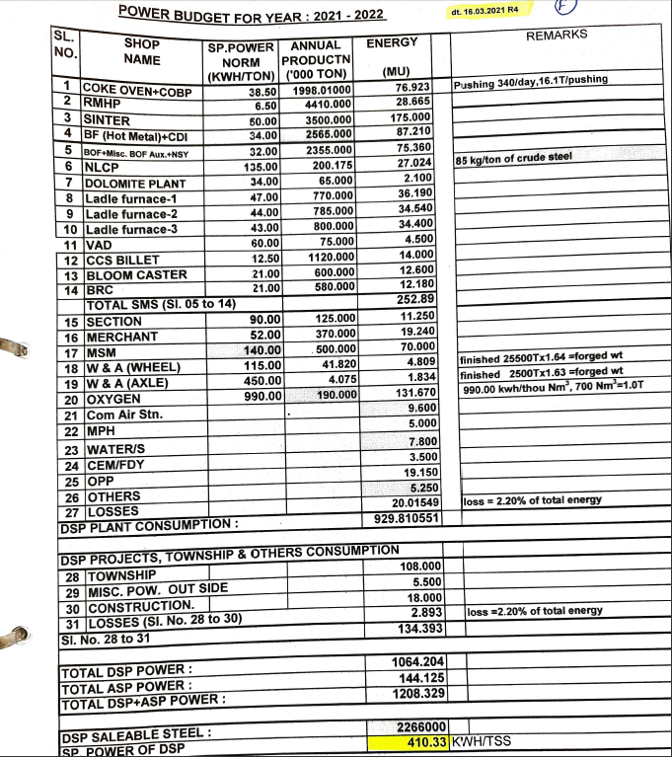
POWER BUDGET

Slide 67
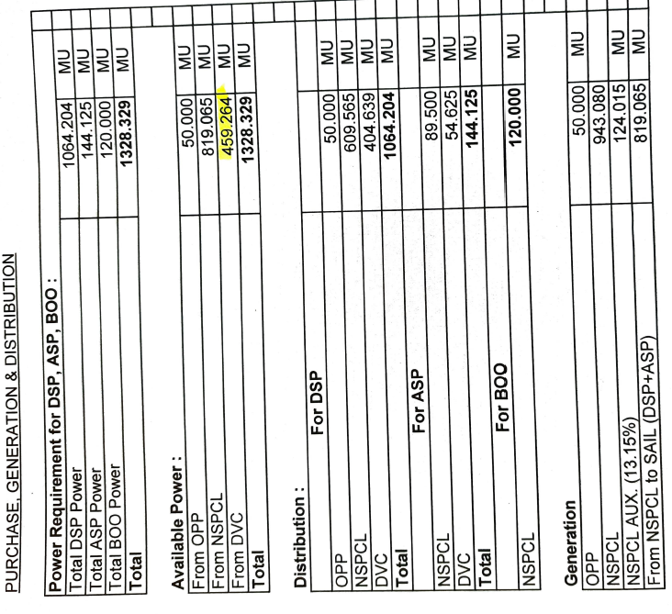
POWER BUDGET

Slide 68
Thank you

